Slide 1
BIG DATA

Slide 2
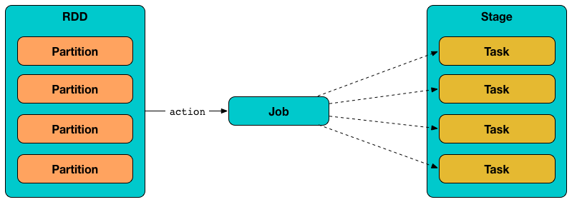
No of task = No of Processors

Slide 3
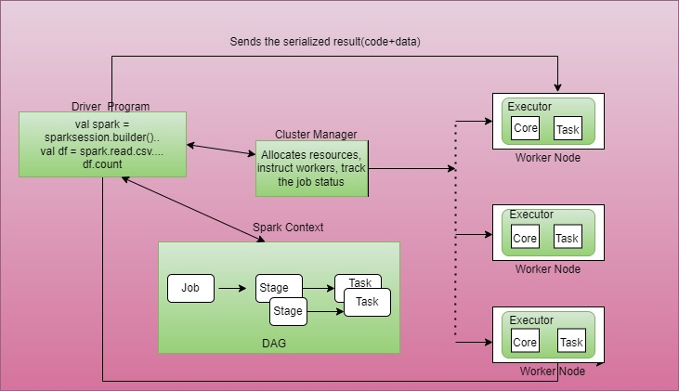

Slide 4
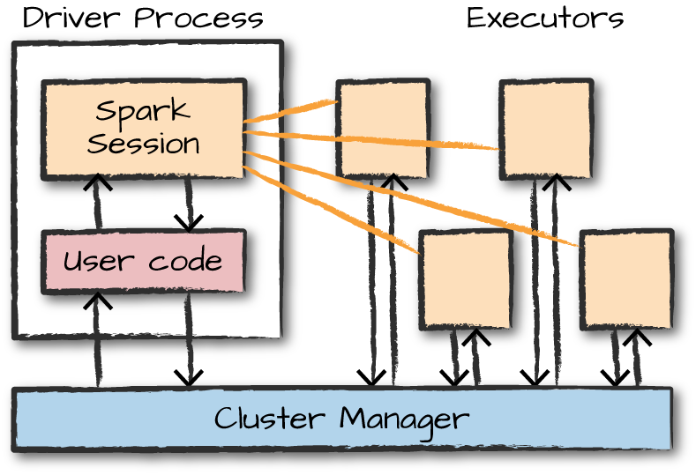

Slide 5
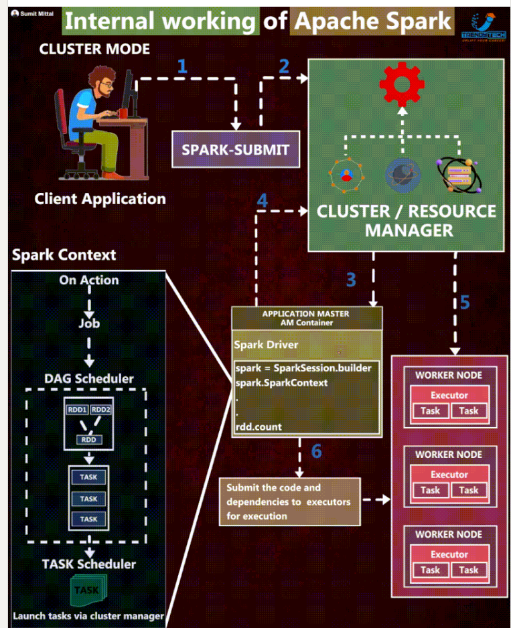

Slide 6
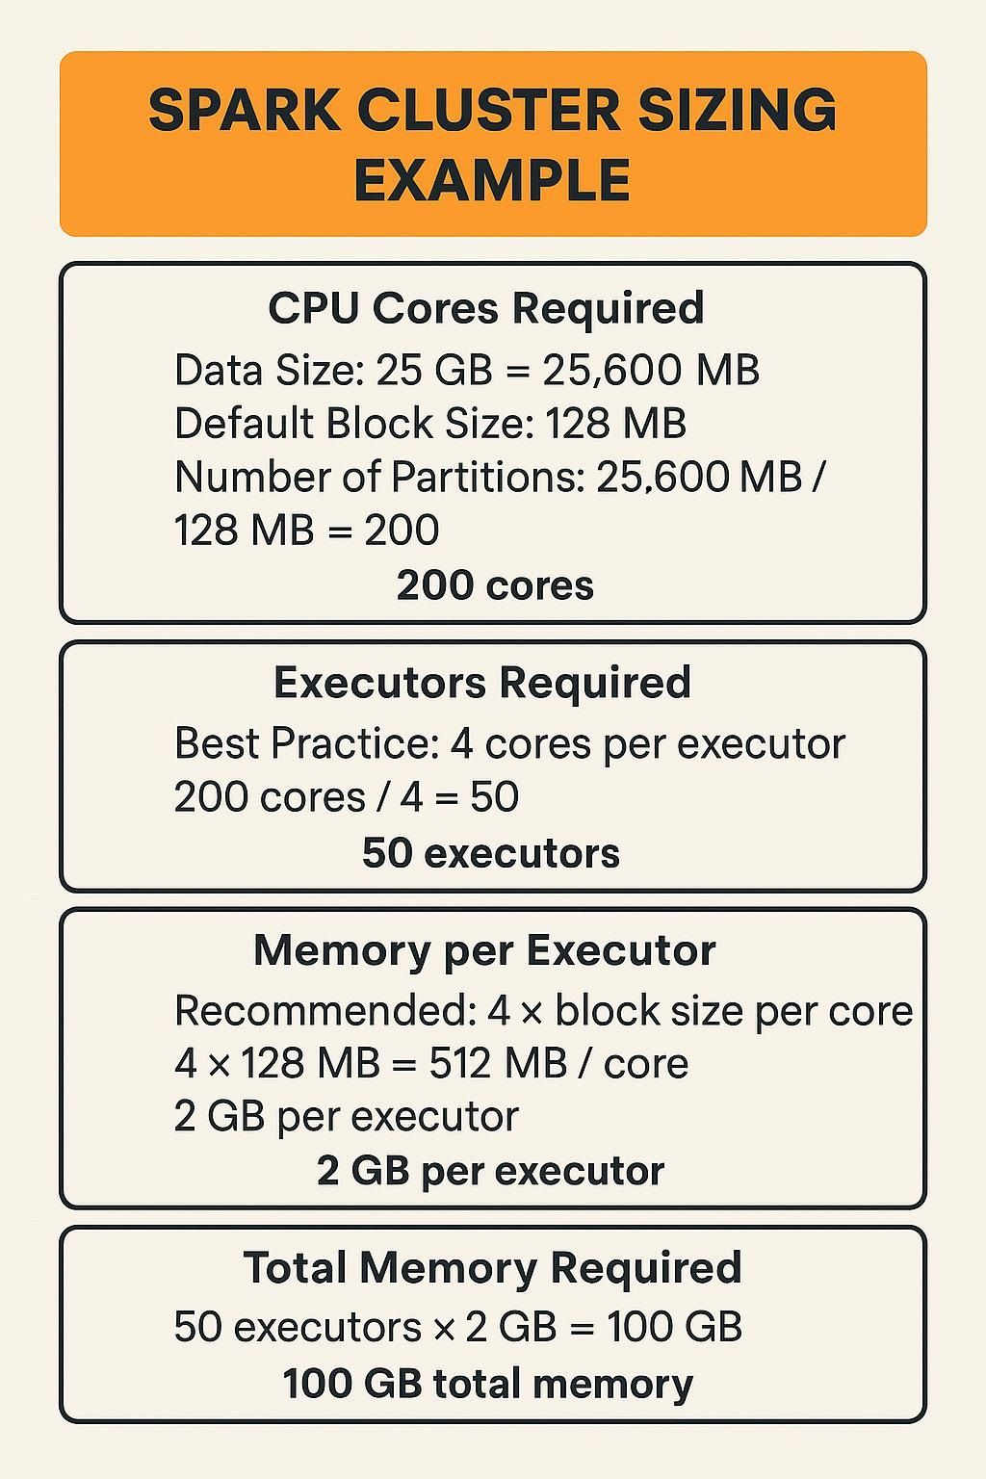

Slide 7
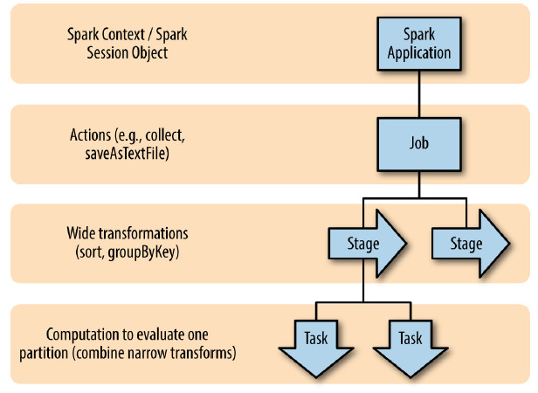

Slide 8
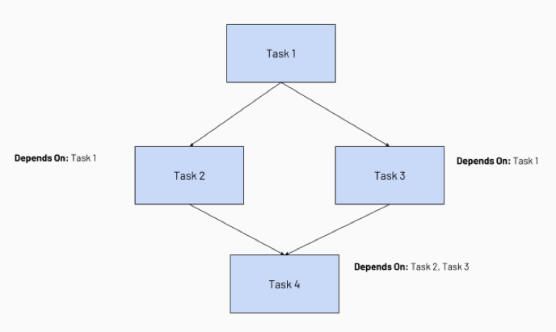
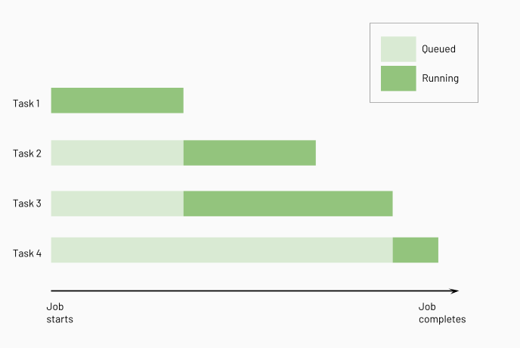

Slide 10
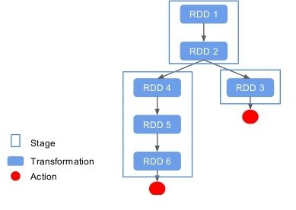

Slide 11
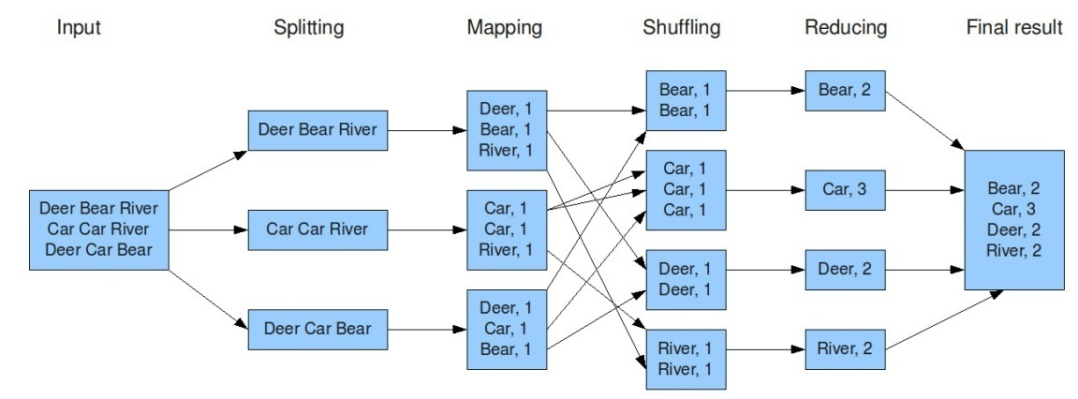

Slide 12
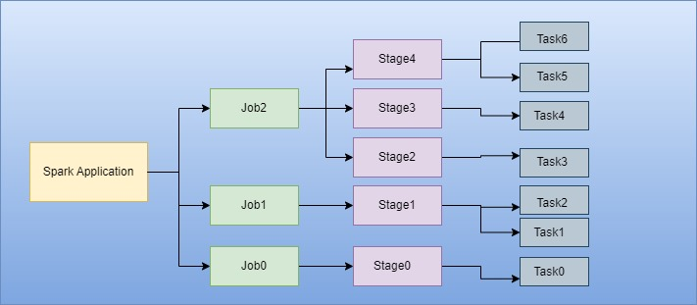

Slide 13

csv
Data Extraction
csv
txt
txt
ETL
jdbc
jdbc
…..
Data Load
…..

Slide 14
CSV in DBFS
PySpark on
DataBricks NoteBook
Postgres
Database in AWS RDS
EXT
LD
Transformation

Slide 15
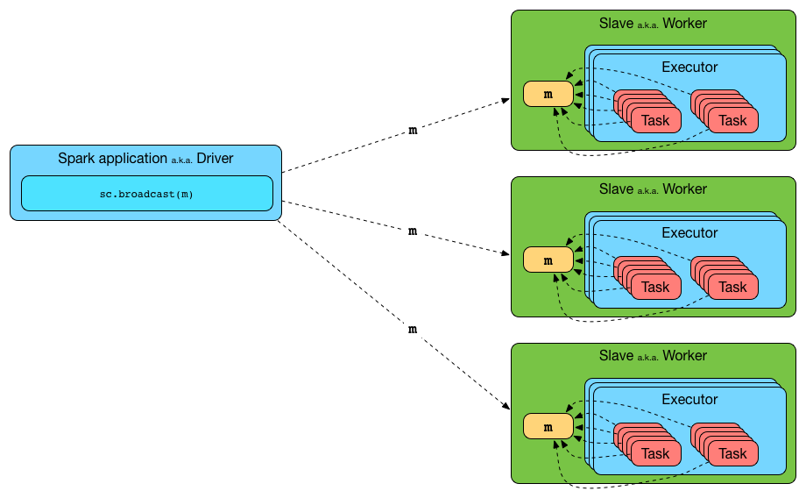

Slide 16
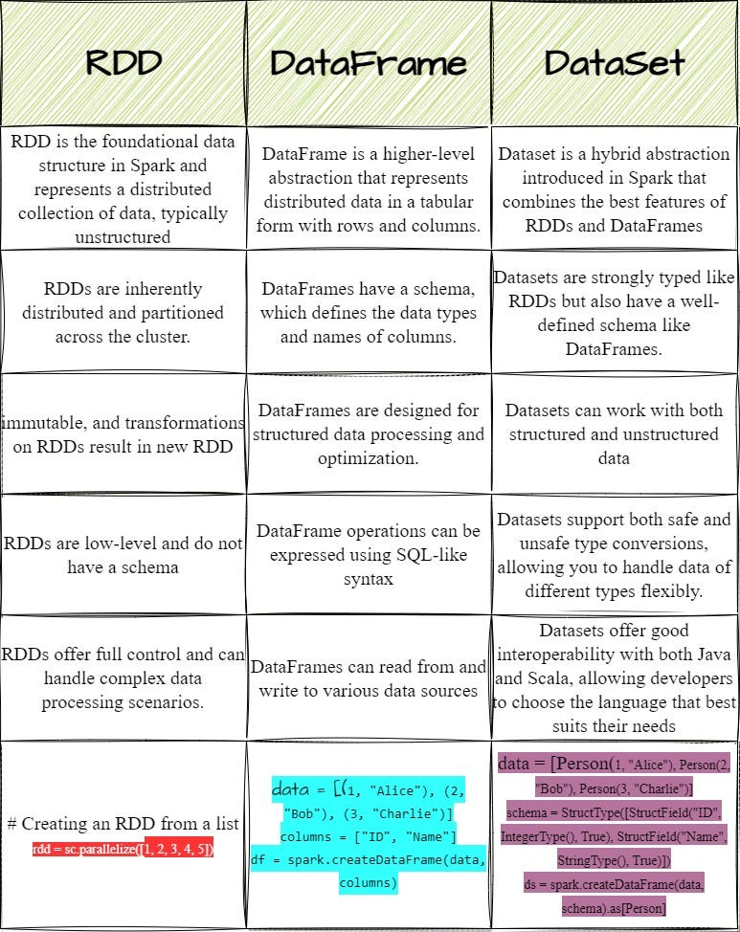


Slide 17


